Slide 2
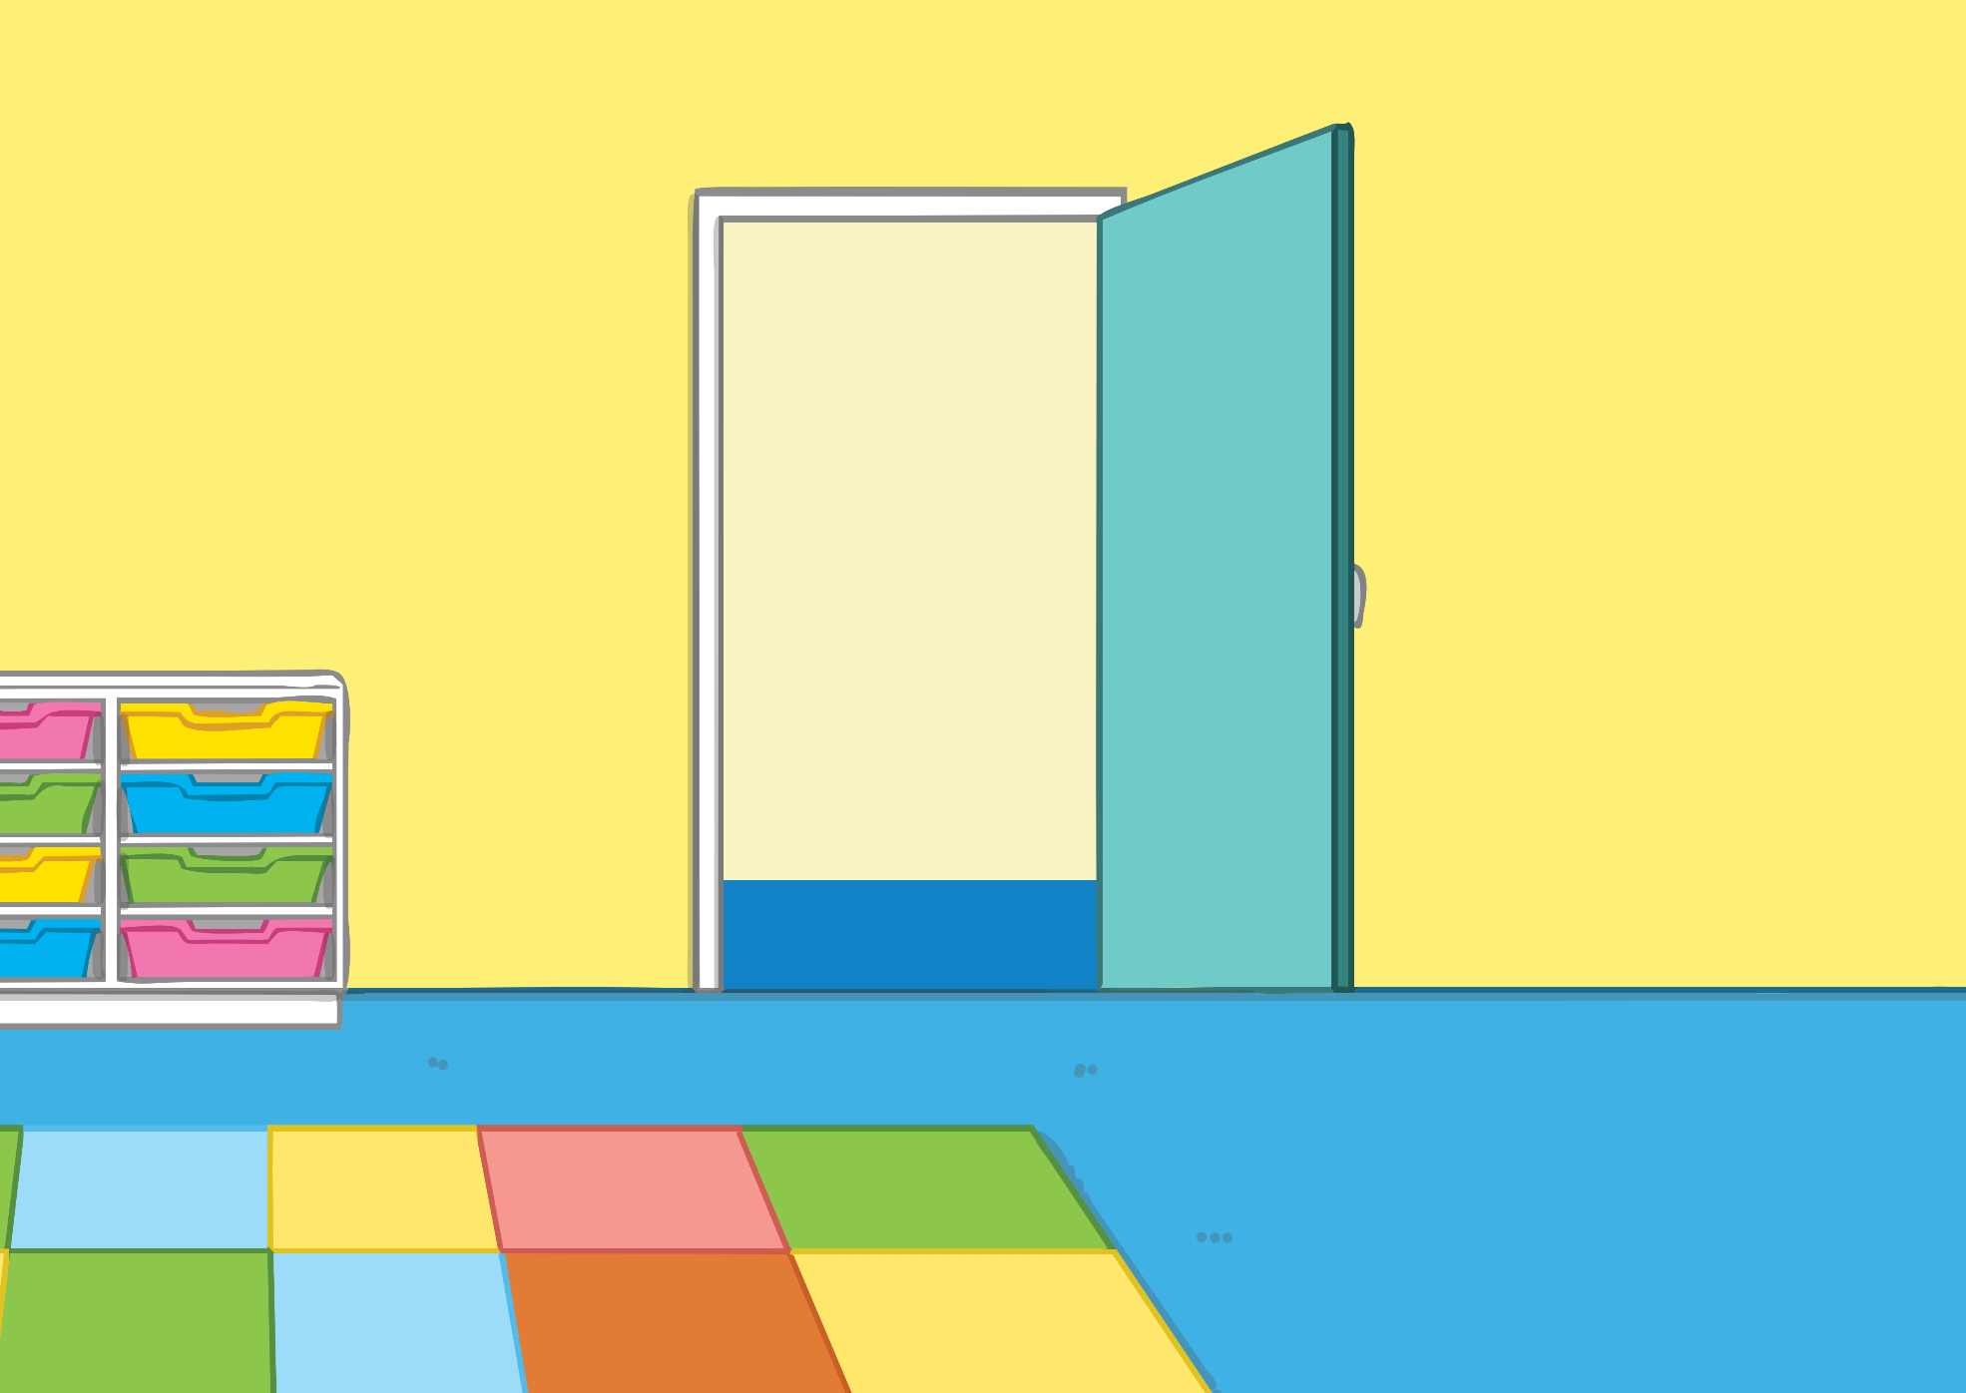
My name is Brodie and I go to Gideon Lakes Primary School. I do lots of fun things at school, like learning and playing with my friends. When I learn in the classroom, I can sit on the floor with other students or at the table. When I play outside, I might play a game or on the playground. I like to play with my friends.

Slide 3
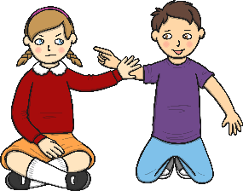
Sometimes when other children are learning or playing, they might accidentally bump into someone or get too close. This is OK and they can apologise.
Sometimes at school, people might touch others when they don’t like it or touch them in a harmful way. This can make people uncomfortable or hurt them.

Slide 4
When I am home, I like to hug my family and friends. My family and friends like to hug me too. We can sit close together to do activities at home. Hugging and being close at home is OK to do if you like hugging.

Slide 5
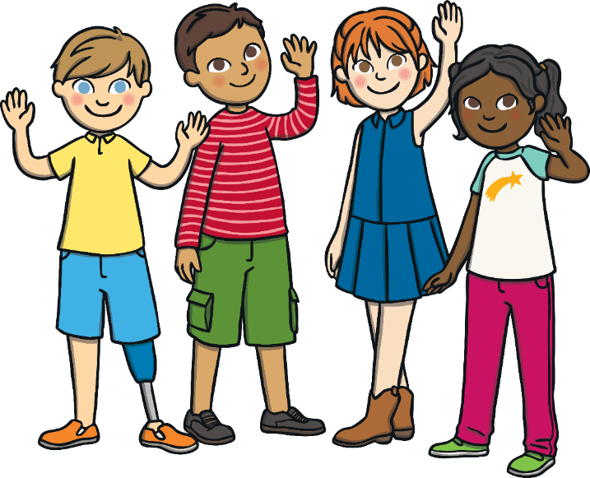
Some ways that we can all learn and play appropriately include:
remembering other people’s personal space;
saying hello, waving or giving a high five;
asking people before touching them;
tapping people on their arm and saying, “excuse me”.

Slide 6
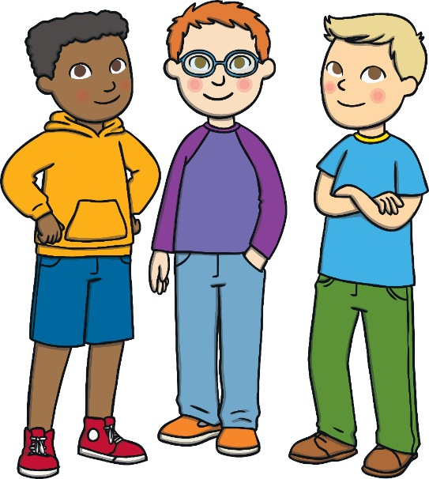
When I am learning and playing with my friends, I will try and remember to give them space. I will think about whether I need to touch them or not.
If I learn and practise appropriate touching, it might make school a better and safer place to learn and play.

